Slide 1
YOUR FIRST TUTORIAL – ACCT 6002
Jane Andrew

Slide 2
Emergency procedures (on campus)
In the unlikely event of an emergency, we may need to evacuate the building.
If we need to evacuate, we will ask you to take your belongings and follow the green exit signs.
We will move a safe distance from the building and maintain physical distancing whilst waiting until the emergency is over.
In some circumstances, we might be asked to remain inside the building for our own safety. We call this a lockdown or shelter-in-place.
More information is available at www.sydney.edu.au/emergency.
Notes:
For face-to-face learning, or if anyone is joining the online class from campus, please be aware of emergency procedures. Due to physical distancing requirements building occupants are not gathering at the usual assembly area when evacuating. The advice is to disperse rather than assemble but you should keep your class together (with physical distancing) if you intend to return to class once the emergency is over. If you intend to end the class, you can let the students disperse.

Slide 3
Keeping our campus COVID-safe
The University is following NSW Government and NSW Health guidance to prevent the spread of COVID-19, respiratory-type illnesses and other illnesses.
All staff, students and visitors are required to follow our health and safety advice. This includes staying at home if unwell, isolating and testing, and to not return unless recovered or as advised by your health professional.
Visit our website for more information about our COVID-19 response.
Notes:
We’re following NSW Government and NSW health guidance. They can visit our website Sydney.edu.au/covid-19 for support including answers to frequently asked questions about COVID safety, study arrangements and who to contact for help.

Slide 4
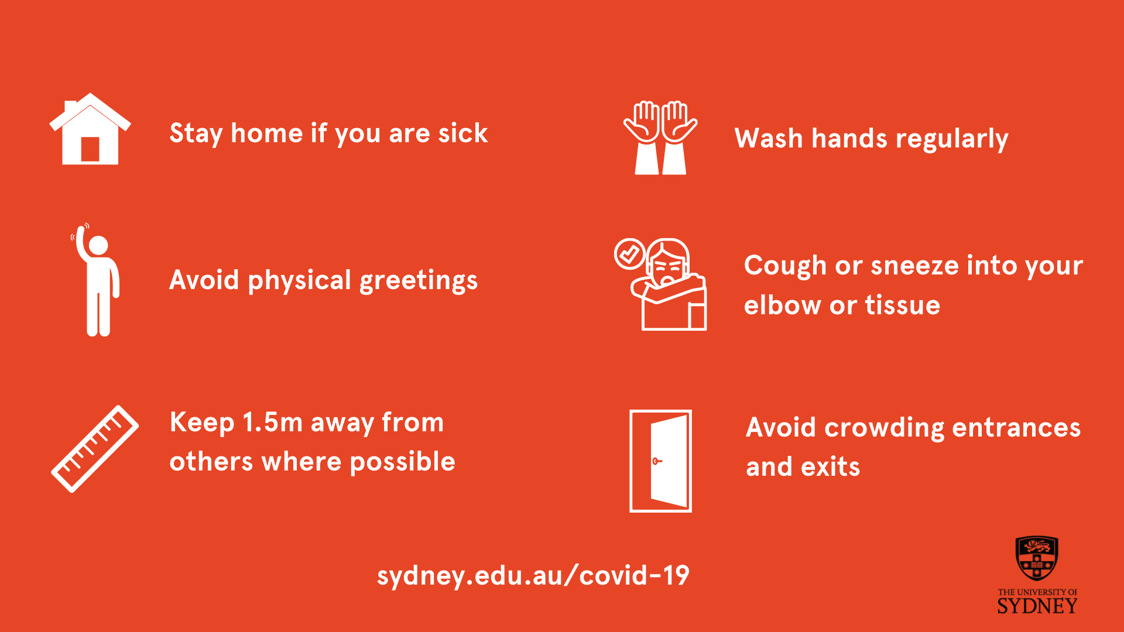
Health and safety advice
Notes:
Remind students to follow standard health and safety precautions, but do not police them other than in settings in which vaccination status has been mandated such as the health settings, requirements from placement providers, and teaching practicums.
These precautions apply when coming to campus and following them on or off campus will also help protect the broader community.
We can all help reduce the spread of COVID-19 by following our health and safety advice:
If unwell or displaying any cold and flu, respiratory-type illnesses or other illnesses, do not come to campus, isolate and test, and do not return unless recovered or as advised by your health professional.
Keep up to date with vaccinations.
Practise good personal hygiene with regular hand hygiene.
Practise cough etiquette (coughing or sneezing into your elbow or tissue).
Wear a mask in crowded settings.
Get plenty of fresh air.
Be aware of and adhere to NSW Health guidance if you have been exposed to COVID-19.
The following precautions are also available on campus:
Cleaning services as per normal schedule.
Readily available sanitisers and disinfectant wipes for self-use surface cleaning.
Ventilated rooms.

Slide 5
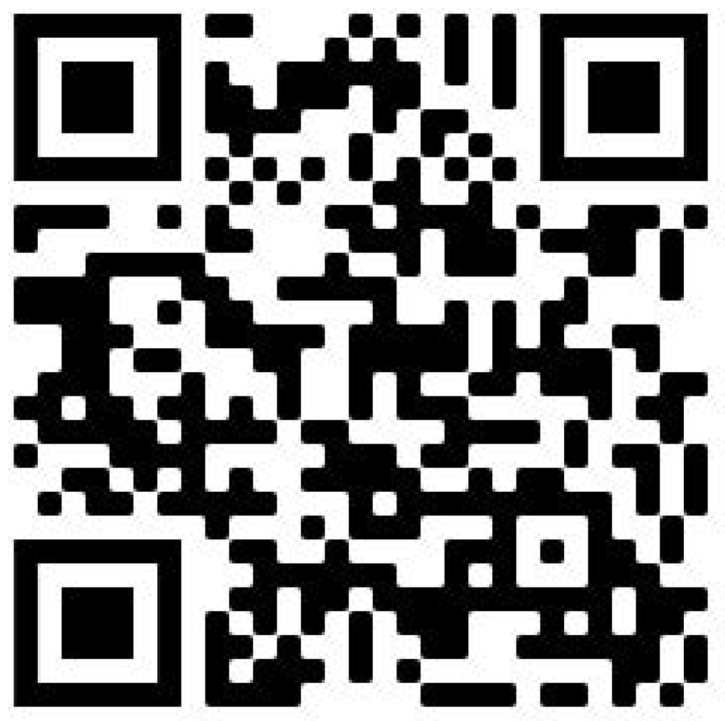

Student support
Visit the Student life, wellbeing and support webpage to find out about the student services, resources and events available to support you while you study:
Health and wellbeing
Academic Support
Personal support
Getting connected
Questions about getting started this semester? Come visit us at a Welcome Hub
Anderson Stuart Welcome Hub
Carslaw West Welcome Hub
Notes:
No matter what kind of help you need, the University is here to support you.
Visit the website to find out what is available to you.
Scan the QR code to access the website.

Slide 6
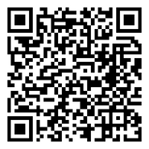
Safer Communities Office
Support and case management for people who have experienced sexual misconduct, domestic/family violence, bullying/harassment or issues relating to modern slavery.
Contact the team
8:30 am to 5:30 pm Monday to Friday, Sydney local time
phone: +61 2 8627 6808
email: safer-communities.officer@sydney.edu.au.
campus: Level 5, Jane Foss Russell building, City Road, Darlington Campus
Make a report
Visit the website to make a complaint or disclosure of sexual misconduct to the University.
Notes:
Students have let us know through the National Student Safety Survey that it can be hard to find information on where to find support or how to make a report for experiences of sexual misconduct.
Here is some more information about our Safer Communities Office, which has specialist staff experience in responding to people who have experienced sexual misconduct and other trauma.

Slide 7

Academic integrity
Academic integrity refers to behaving honestly, ethically and responsibly in relation to all elements of your study at the university, including assessments.
Always submit your own work, sit your own tests, and take your own examinations.
Acknowledge any contributions in your assignment which are not your original thoughts, ideas or words.
Writing technologies (e.g. ChatGPT, Grammarly, etc) cannot be used to create or modify work for submission, unless expressly permitted by your unit coordinator.
Academic Honesty Education Module – all commencing students must complete by census date. Continuing students can self-enrol at any time.
Notes:
We'd like to take the opportunity at the beginning of semester to remind you about some core academic integrity principles and the expectations of all students for academic honesty.
The core values that the underpin the concept of academic integrity are honesty, trust, fairness, respect and responsibility.
At university, behaving with academic honesty means doing your own work even if you find the work challenging. This means that you do not try to benefit academically by misleading or being unfair to others.
Academic integrity is embedded into every area of study and research at the University. It is important that you understand the expectations of acknowledging sources within your disciplines to avoid plagiarism, learn how to detect and deter contract cheating opportunities and work with groups in legitimate ways when required to do so.
The University is aware of the emergence of AI tools like ChatGPT. These cannot be used to create or modify work for submission, unless expressly permitted by your unit coordinator.
If you are a commencing student, please make sure you complete the Academic Honesty Education Module in Canvas by the census date.
If you are a continuing student and would like a refresher, you can self-enrol in the module.

Slide 8
Tips for students learning online
Remember that you are still in a space with other students.
Mute your microphone when not speaking.
Use earphones or headphones - the mic is better and you'll disturb others less.
If you have a webcam, please switch it on so we can see you, if you are comfortable doing so.
Try not to talk over someone else.
Some classes may use breakout rooms – engaging fully in these is a great way to meet classmates and your teachers.
Help your teachers know you're there by participating in chat, polls and other activities during class - we're all in this together.
Notes:
This is an optional slide for use with hybrid or online classes.
For those of you haven’t taken part in online classes before, here are a few tips to help make it a great experience and ways to communicate with each other during the class.

Slide 9
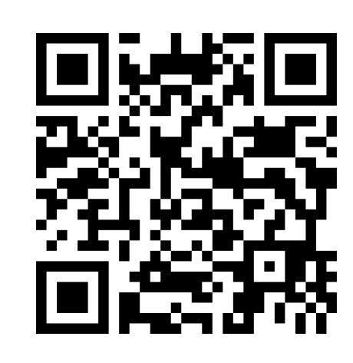
Menti - Icebreaker
https://www.menti.com/al779thuby5x

Slide 10
Canvas Tour
https://canvas.sydney.edu.au/courses/48054
Watch video welcome
Topic schedule
Assignment
Reading list for assignment
Self study resources

Slide 11
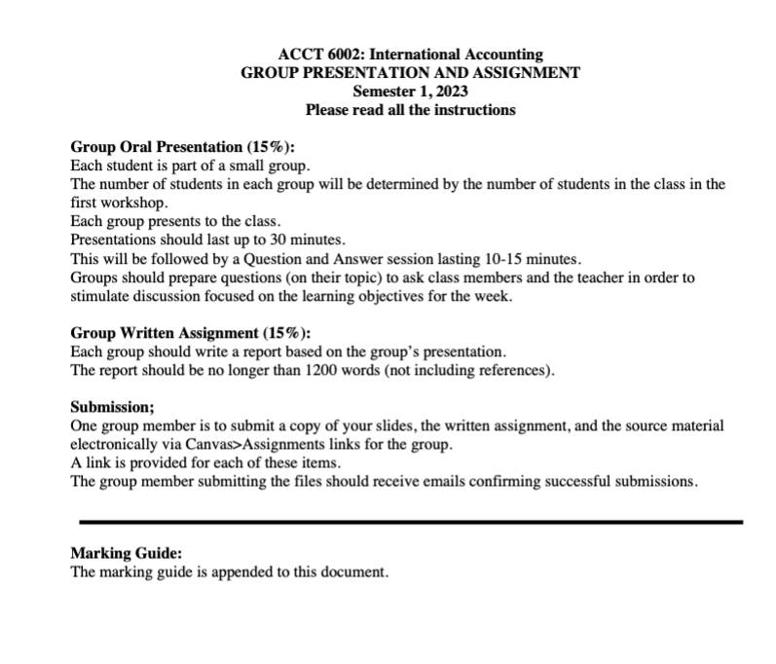
Assignment

